Slide 1
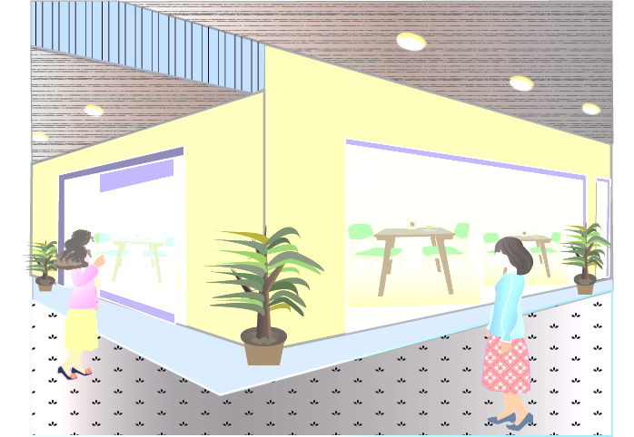
特長１のイラストに採用
3D LiDAR
Photo
Detector
Scanning target
Laser
Diode
Vertical mirror angle
Vertical
scanning(60º ）
Change mirror angle
by up and down
movement of Motor2
Returning laser light
Emitting laser light
Up and down
movement
Mirror
Horizontal rotation
Horizontal scanning (270º ）
Motor 1
Motor 2

Slide 2
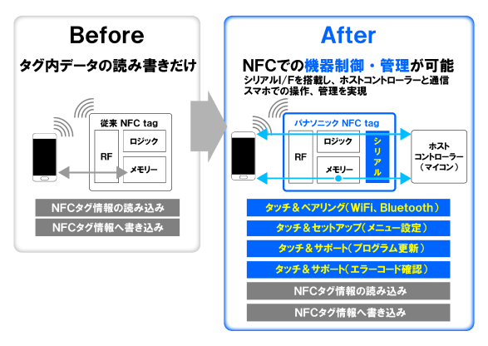
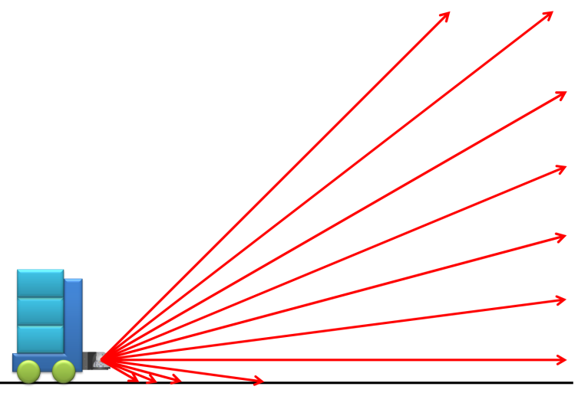
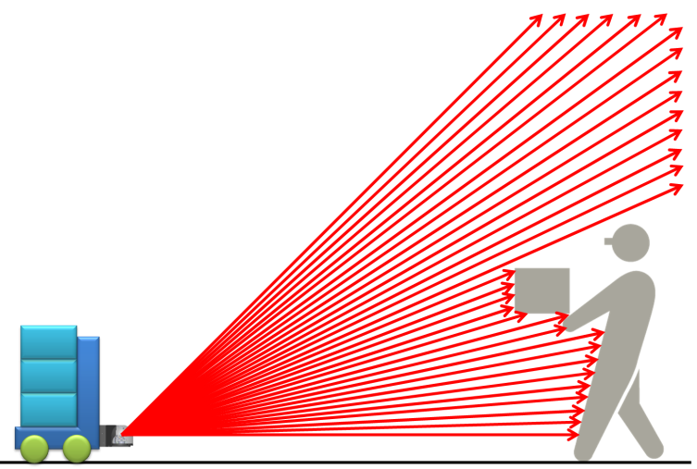
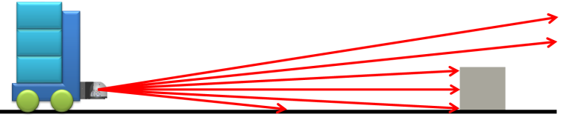
特長2のイラストに採用
Use case 1)
Use case 2)
Moving on flat surface with
less moving objects in the area
Moving in the area with many moving objects
Quick scan in narrow range.
Quick scan in wide range.
After detecting the obstacle,
change the scanning range and resolution to detect details.

Slide 3
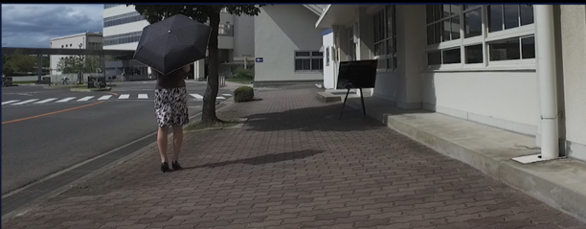
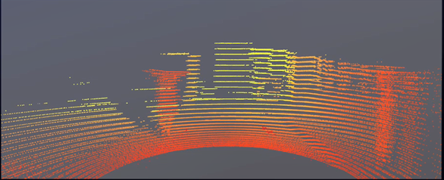
特長3のイラストに採用
Water
plumbing
Water
plumbing
Person
Road shoulder
Person
Road shoulder

